Slide 1
Laboratory Records
Open https://pad.carpentries.org/2022-02-16-ed-dash-fair

Slide 2
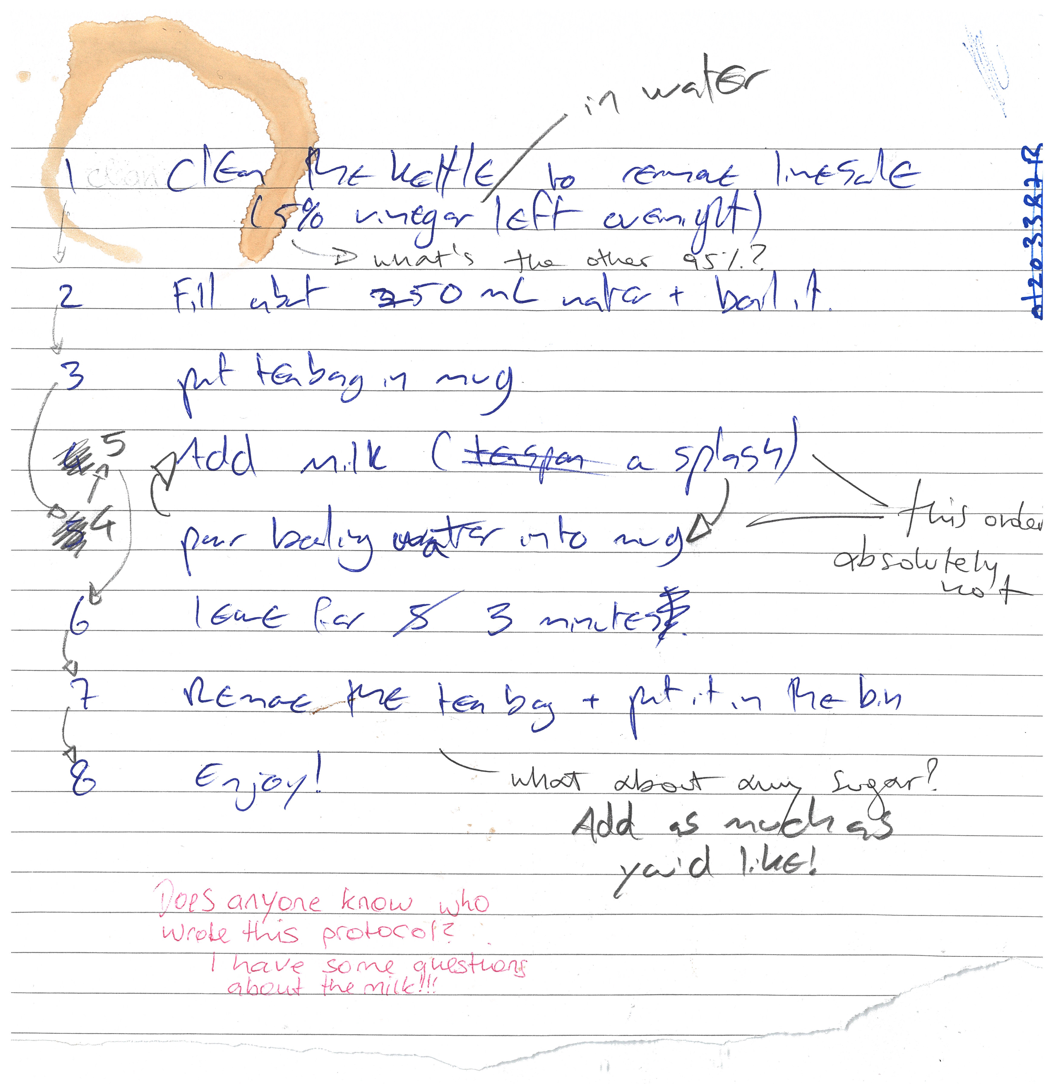
Before we start this session on good record keeping, it might be a good idea to make ourselves a cup of tea.
Here’s a peer-reviewed protocol
for making tea
Once you have your tea, remember to sign up for your benchling and protocols.io accounts (links on the pad)
Figure credits: Dr Ines Boehm and Ben Thomas

Slide 3

Exercise/challenge 1
Differences between analogue and digital record keeping
Notes:
Advantages of traditional analog records
Ability to directly draw on your records
works regardless of internet/power access
Disadvantages of traditional analog records
can be lost and/or damaged (not Findable or Accessible)
only in one location at any time (not Findable or Accessible)
handwriting can make it less intelligible
harder to edit/move elements around smoothly (not Interoperable)
can’t store most data types (e.g. imaging data) in a useable way (not Reusable)
Advantages of digital records
Intelligible: can smoothly and easily move elements around to edit it
Findable and Accessible: can be shared instantly anywhere around the world, with anyone
Interoperable: can be easily commented on by anyone anywhere
doesn’t take up physical space (no record rooms/folders)
regular backups mean it won’t be lost
Reusable: version controls mean changes can easily be tracked
Reusable: can store protocols directly with other supporting data types (e.g. video explanations)
can you think of more?
Disadvantages of digital records
dependent on internet access and power (not Accessible)
some digital record keeping services charge a fee
risk of corruption if data is not backed up (either yourself or by the service used - not Reusable)

Slide 4
Advantages of traditional analog records
Ability to directly draw on your records
works regardless of internet/power access
Disadvantages of traditional analog records
can be lost and/or damaged (not Findable or Accessible)
only in one location at any time (not Findable or Accessible)
handwriting can make it less intelligible
harder to edit/move elements around smoothly (not Interoperable)
can’t store most data types (e.g. imaging data) in a useable way (not Reusable)
Advantages of digital records
can smoothly and easily move elements around to edit it
Findable and Accessible: can be shared instantly anywhere around the world, with anyone
Interoperable: can be easily commented on by anyone anywhere
doesn’t take up physical space (no record rooms/folders)
regular backups mean it won’t be lost
Reusable: version controls mean changes can easily be tracked
Reusable: can store protocols directly with other supporting data types (e.g. video explanations)
can you think of more?
Disadvantages of digital records
dependent on internet access and power (not Accessible)
some digital record keeping services charge a fee
risk of corruption if data is not backed up (either yourself or by the service used - not Reusable)
Notes:
Intelligible: able to be understood especially: clear enough to be heard, read, etc.

Slide 5
Why do we need to keep good quality records?
Good record keeping ensures:
Transparency
Reproducibility
Accountability
Good scientific practice
Notes:
One prime example of why this is necessary is the recent data scandal surrounding Novartis’ FDA approved gene therapy Zolgensma, for the fatal childhood motor neuron disease Spinal Muscular Atrophy (the most expensive treatment ever approved). Novartis submitted manipulated data, showing that the comparison of two versions of Zolgensma in Phase 1 and Phase 3 testing had similar therapeutic activity. How can we prevent the occurrence of data manipulation such as this in the future, or…
replacing the defective or missing SMN1 gene to halt disease progression with a single, one-time infusion

Slide 6
How can we as a research community implement practices to make it easier to find manipulated records?
FAIR record keeping
In order to avoid data mismanagement and unexplained discrepancies, it is imperative to keep dated, accurate, complete and intelligible records of our experiments and the protocols we use. This means they should include enough detail for others to reproduce.
You are, legally, the one responsible for your records, not your colleague, or your PI.
Notes:
FAIR record keeping, for example version control can help, as it shows what changes have been made when in electronic laboratory notebooks (ELNs), which will make it difficult to manipulate results such as this without leaving a trace.
In order to avoid data mismanagement and such unexplained discrepancies, it is imperative to keep dated, accurate, complete and intelligible records of our experiments and the protocols we use. This means they should include enough detail for others to reproduce under ideally the same conditions. You are, legally (!!) the one responsible for your records, not your colleague, or your PI.

Slide 7
How can we as a research community implement practices to make it easier to find manipulated records?
Protocols and laboratory records need to be:
detailed
kept accurate and complete
They should be accessible (physically and/or electronically) to others both short and long term
Regular back-ups on a cloud and physical hard-drive to ensure appropriate archiving.
records should be kept in compliance with departmental, institutional, and other regulatory requirements, with special care given to human and animal research records
A few common guidelines of good record keeping for protocols and laboratory notebooks are the following:

Slide 8
Laboratory Notebooks
contain all relevant details (what, when why and how you did it)
who you are (the person creating the record)
which project(s) is the record part of
information on lot/batch numbers
what happened and what did not happen (data, including images)
how you processed and analysed the data
your interpretation (and the interpretations of others if important) and next steps in the project based on these results
should be well organised for ease of navigation (indexed, labelled, catalogued)
accurate and complete: include all original data and important study details (metadata).

Slide 9
Protocols
who created the protocol if not you
complete and detailed instructions describing why and how to do an experiment
what special materials and instruments are being used and where they were obtained
health and safety advice and how to dispose of waste
allow repetition of your procedures and studies by yourself and others

Slide 10
Why do we want to keep FAIR records?
Focusing on FAIR this keeps our records Findable, Accessible, Interoperable as well as Re-usable.
Accessibility that allows better reuse increases our citations and visibility in the field, digital record keeping increases the legibility of notes and provenance (tracking of dates and origins of work) allow for better reproducibility which we have discussed in the previous lesson.
Greater accessibility affords accountability to the original creator of the work. We will now show you how easy it is to share records once they are online, and address some benefits that new repositories such as electronic lab notebooks (ELNs) or online protocols have.
Notes:
There are multiple repo’s for ELNs and online protocols. We will discuss two free options that are easy to use: Benchling and procols.io If you have not created accounts yet for both of them, please do so now as you will need them for the following exercises.

Slide 11
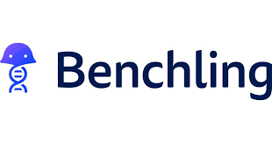
Exercise/challenge 2:
Re-using a published lab entry

Slide 12
Exercise/challenge 3:
Adapting a protocol to your needs

Slide 13
Exercise/challenge 4:
Sharing your record

Slide 14
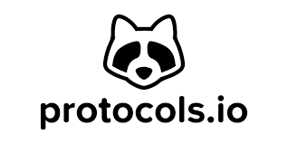
Exercise/challenge 5:
Adapt a public protocol and retain its provenance

Slide 15
How to chose the right platform?
There are more than a 100 platforms that provide services to host electronic lab notebooks or protocols, therefore it can seem quite daunting trying to find the right platform. There is some advice we can offer when looking for the right service.
Compliance with departmental, institutional, and other regulatory and legal requirements (including where data is geographically located, and which types of data can and cannot be stored).
Price (is it free?), check if your institution has a subscription to any.
Maturity of the ELN (is it a brand new ELN, or has it been established for a while now, i.e. is there a risk of the ELN disappearing & data being lost?).
Sharing & exporting capabilities, experience of colleagues, availability of support, integration with other relevant platforms (e.g. dropbox), and the potential for use with mobile devices if required?
What is the user interface like? Does it feel intuitive or does it take you days to find what you are looking for?
Check for operating system compatibility and real time collaboration.
Preferably it should be Open Source.
The BioRDM team has put together a summary of most used ELNs on the University of Edinburgh Wiki where they test-ran a handful of ELNs for you so you can make a more informed choice.

Slide 16
Exercise/challenge 6:
Do you use an ELN? Which one? What features do you like?

Slide 17
How does good record keeping help us get FAIR ready?
Accessibility of your protocols online allows to share them with collaborators who need them for a publication and a DOI of said protocols allows to cite them with credibility.
Electronic lab records allow for easier re-usability and access of your data across multiple platforms. Changes in your records can be traced back, therefore giving accountability.

Slide 18

Record Keeping Quiz

